Slide 1
Bubbl(e)
A social media experience for those that want to connect without leaving their comfort bubble.

Slide 2
Introductions
SCRUM Master
Carly Peterson (They/She)
Team 1
Diana Dinh-Andrus (She/Her)
Fanzhong Zeng (He/Him)
Kaleb Conner (He/Him)
Team 3
Mharvinn Calitis (He/Him)
David Ademola (He/Him)
David Abdhir (He/Him)
Renhan Huai (He/Him)
Team 2
Henry Ramirez (He/Him)
Zhenwen Wang (He/Him)
Dhrubo Talukdar (He/Him)
Jonathon Lachlan (He/Him)
Team 4
April Weaver (She/Her)
Dalton McKinney (He/Him)
James Camel (He/Him)
Michael Ledesma (He/Him)

Slide 3
Story Pointing and Sprints
User Stories by Points
2 - Login
3 - Registration
3 - Like a Post
3 - Comments
5 - Profile
5 - Create Post
5 - Followers
5 - Feed
MVP
login
Micro 1
Micro 2
register
profile
create-post
like-post
feed
followers
comments
Pts
7
8
8
8

Slide 4
Git Flow and Branching
Back End & Front End
main
staging
dev-login
dev-register
dev-profile
dev-create-post
dev-feed
dev-followers
dev-like-post
dev-comments

Slide 5
Bubbl(e) Features Demonstration
Features:
Register
Login
View your Profile
Create a Post
Follow/Unfollow Friend
View Others’ Posts
Like/Unlike Post
Comment Post
http://54.242.69.21/
Notes:
Include Responsive Design demo in larger demo

Slide 6
Technology
Back End
Spring Boot
Spring Data
Lombok
Log4j2
Hibernate
JPA
JUnit5
Front End
Angular
Pipeline/Version Control
Jenkins
Docker
GitHub
Sonar Cloud
Notes:
Add Logo Pictures?

Slide 7
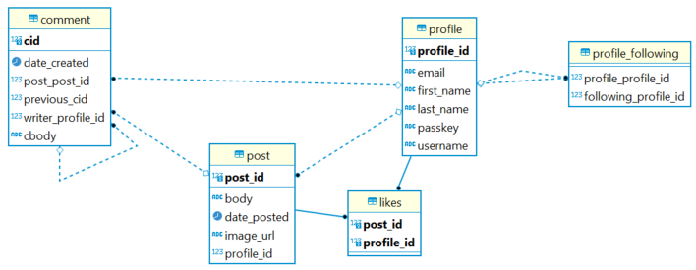
Entity Relationship Diagram

Slide 8
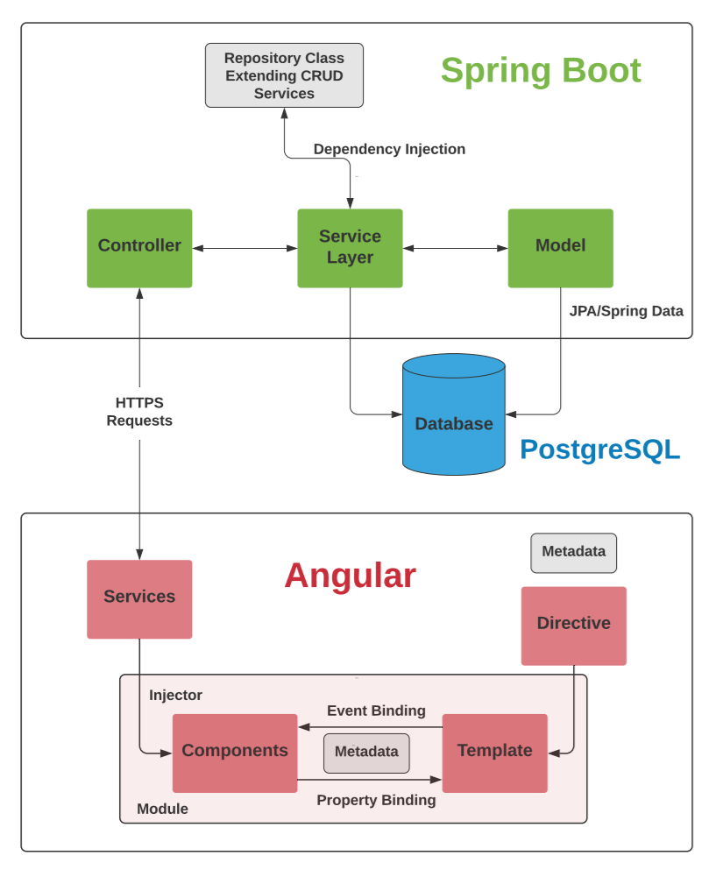
Architecture

Slide 9
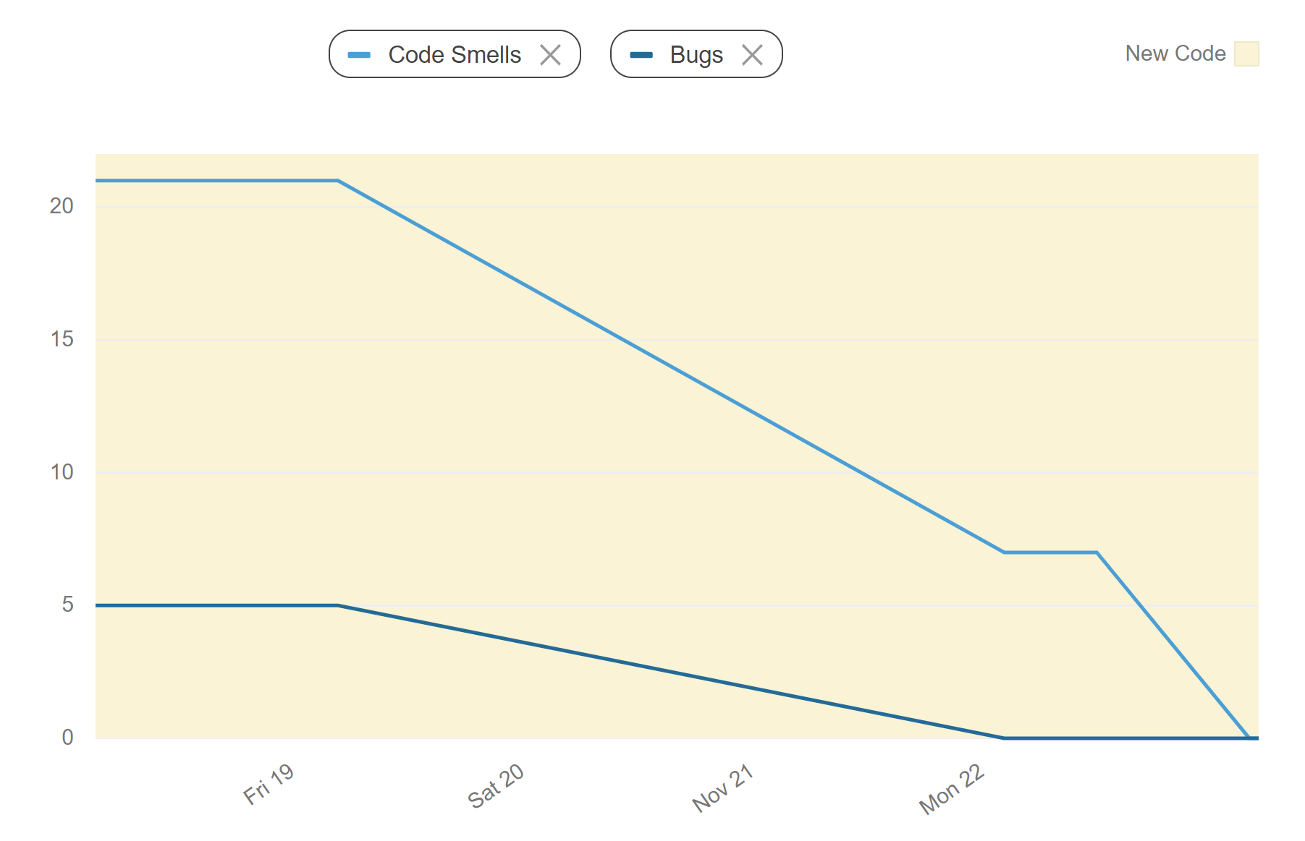
Code Quality Statistics - Frontend

Slide 10
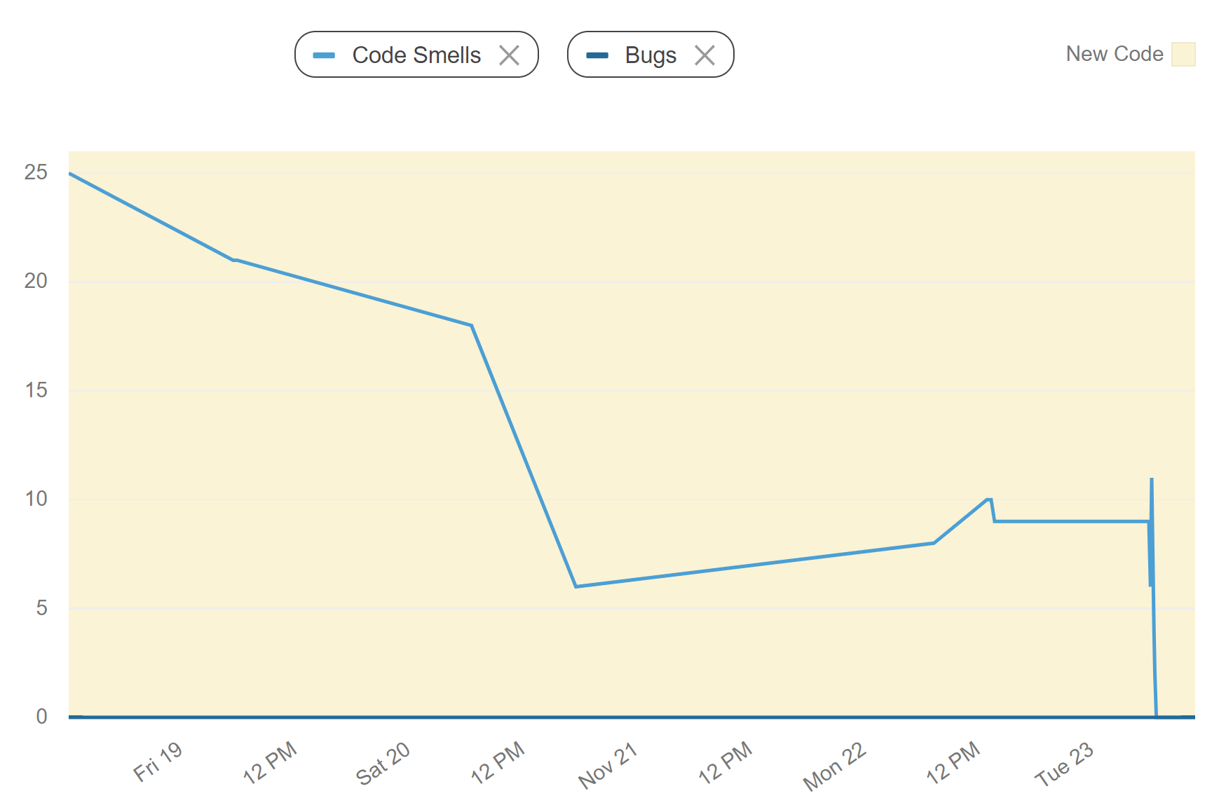
Code Quality Statistics - Backend

Slide 11
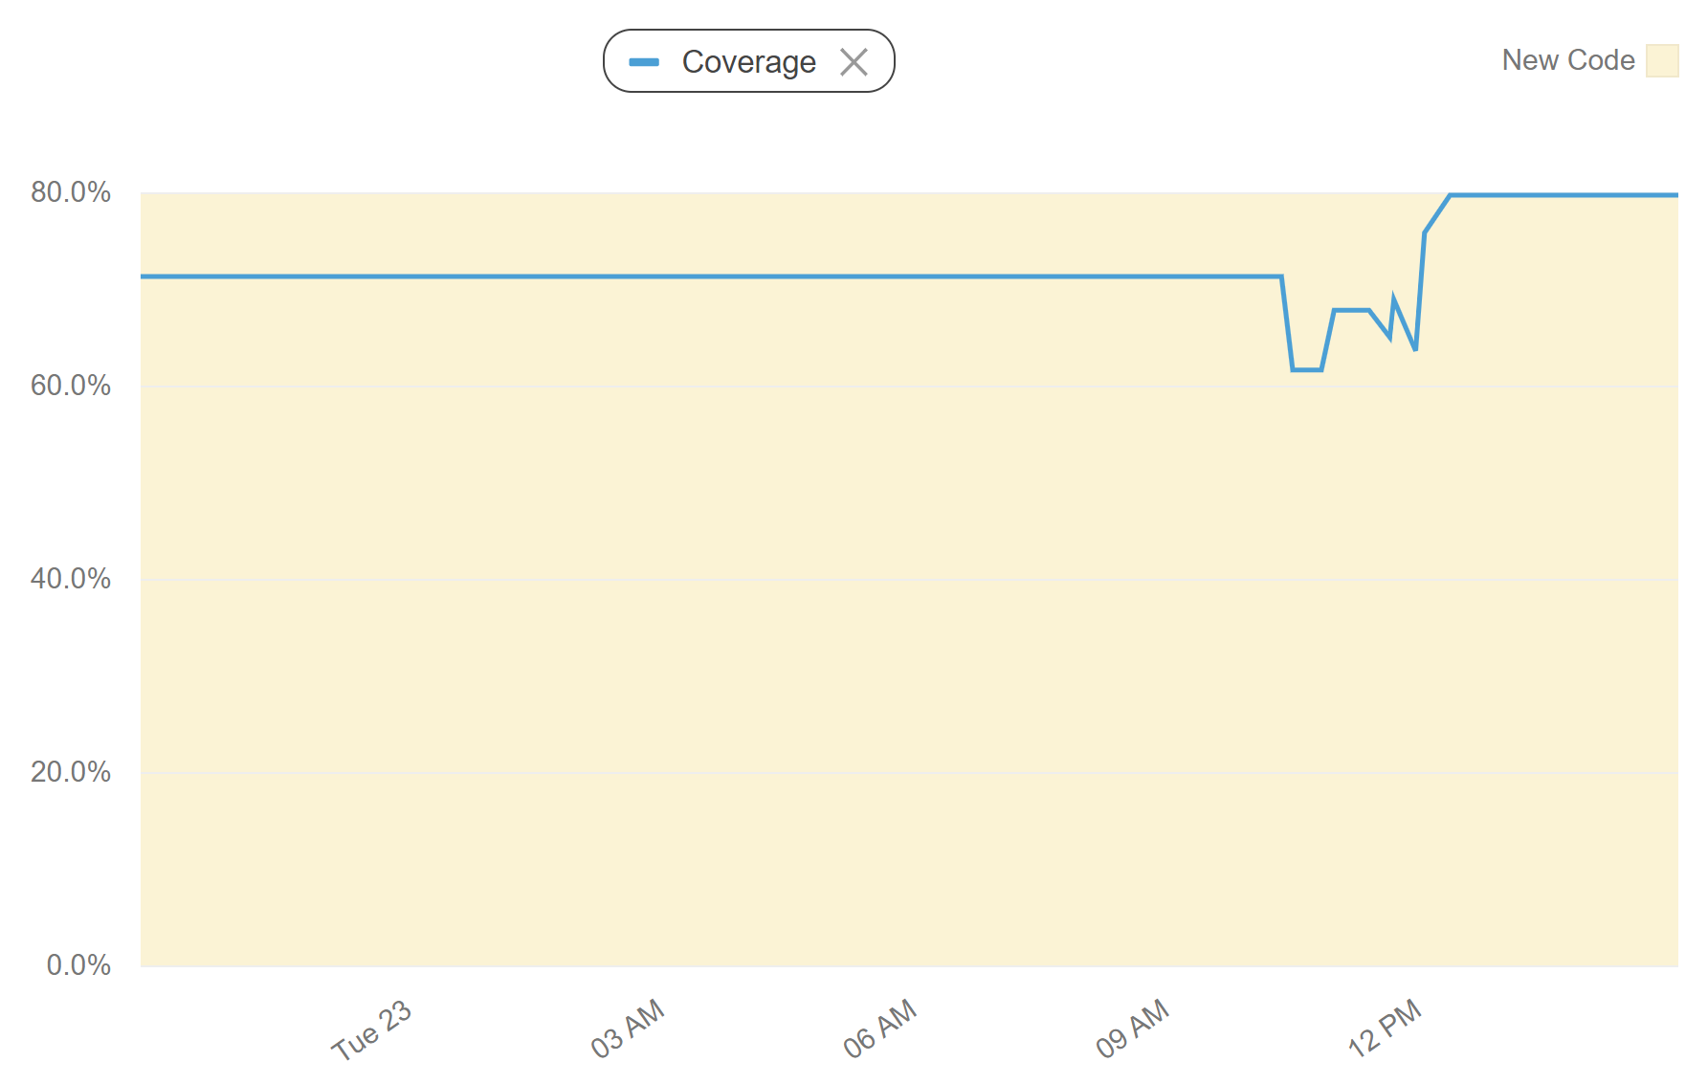
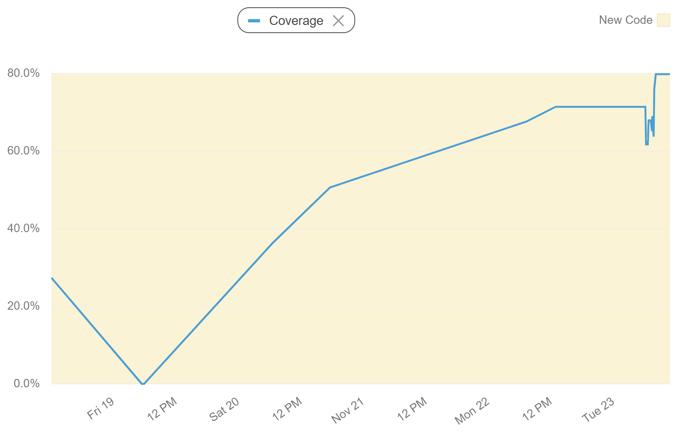
Testing Statistics - Backend

Slide 12
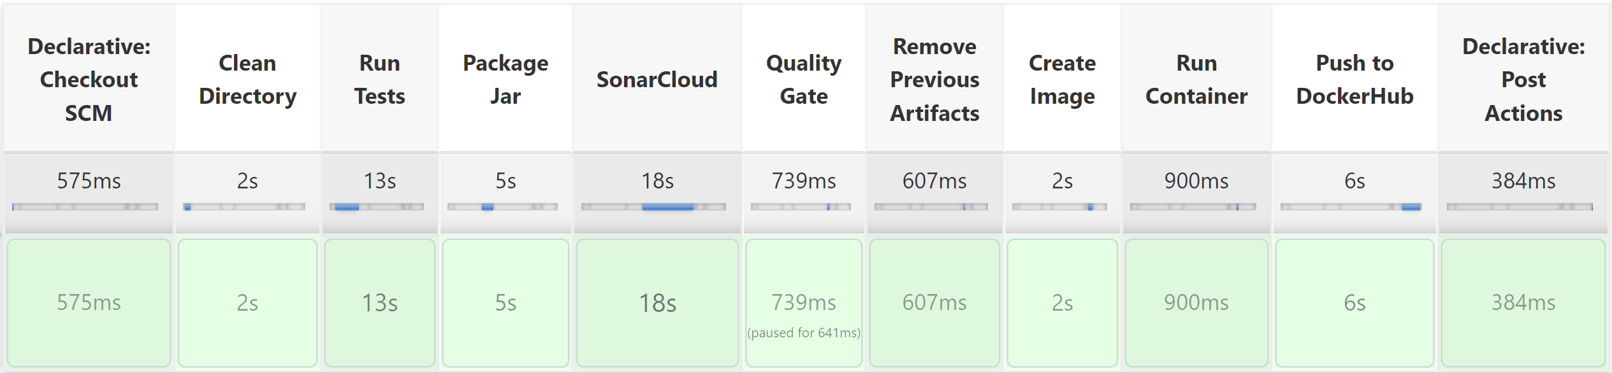
Back End Pipeline Statistics

Slide 13
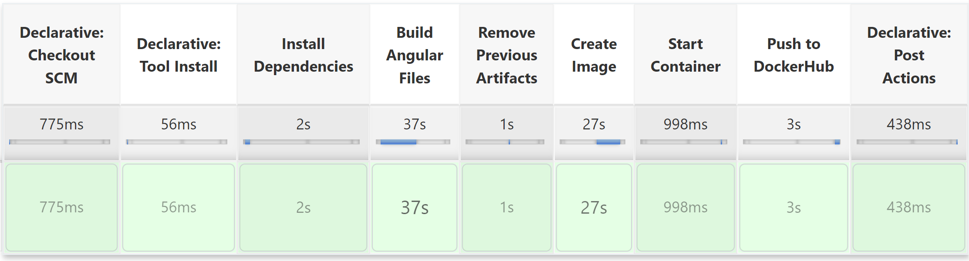
Front End Pipeline Statistics

Slide 14
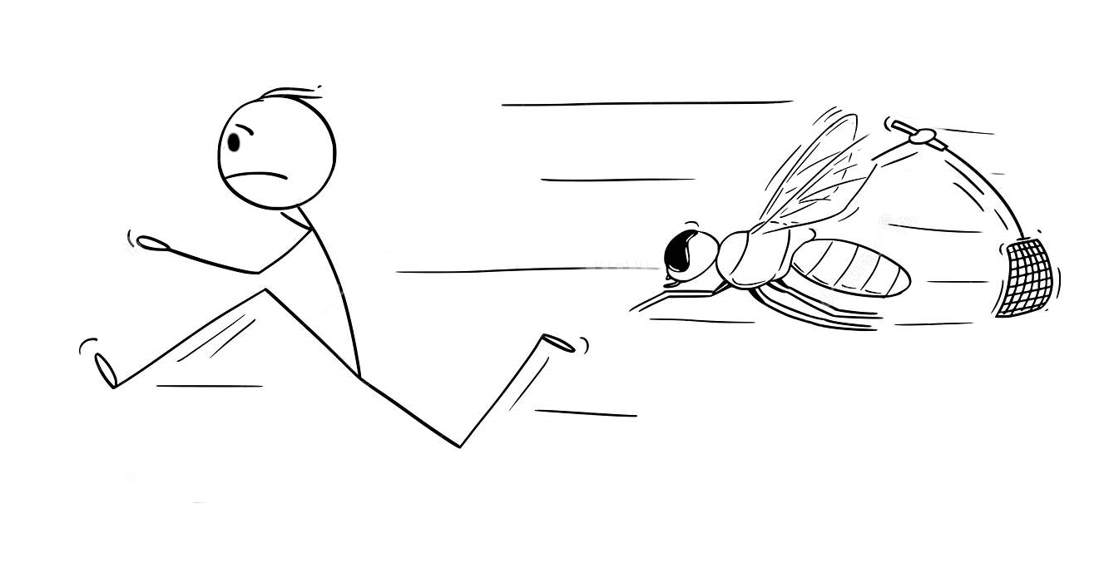
Outstanding Bugs
Follower Bug
Mutual followers cannot log in
Adding additional follows inconsistent
Post feed and home container heights conflict
No text wrap on comments

Slide 15
Project Challenges
Integration of the branches
ManytoMany join table implementation
Likes table
Followers table
Cascading delete on comments
Implementing Spring data methods

Slide 16
Project Highlights
Dhrubo‘s depth of field effect
Like button implementation
Responsive design
Nested comment-reply implementation

Slide 17
Acknowledgements
Carolyn Rehm
Nick Jurczak
Andrew Crenwelge
Andrew Shields
Stack Overflow
Google
W3 School
Java API Documentation
Oracle
Geeks4Geeks
Angular API Documentation

Slide 18
Questions and Comments
This is why I invented coding, to see them knock all your socks off!
-- Definitely Ada Lovelace
They are all just the coolest!
-- Alan Turing Probably
Any more questions?
How can I work with them?
-- Steve Jobs I guess
How did I get so lucky with my group?
-- Carolyn Rehm most definitely

Slide 19
Question Suggestions
What are some features you would like to implement in the future?
What are some features that were more difficult or easier to implement?
Did you learn anything new while doing this project?
What are your opinions on the techonolgies used in this project?
How would you do this project differently?

